Slide 1
Scrapy VS urllib2

Slide 2
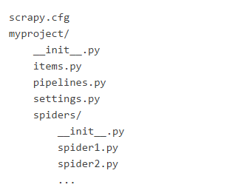
Scrapy introduction
Default structure of Scrapy projects
scrapy startproject “your_project_name”

Slide 3
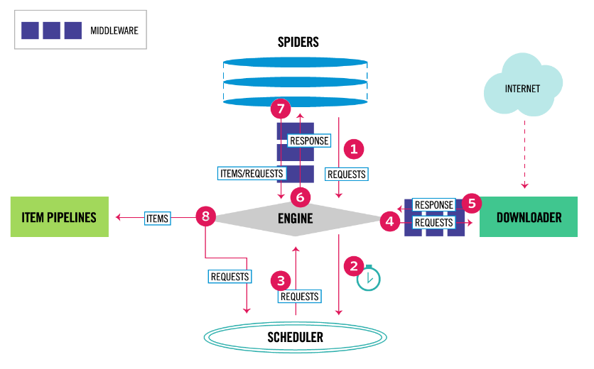
Scrapy introduction
Data flow

Slide 4
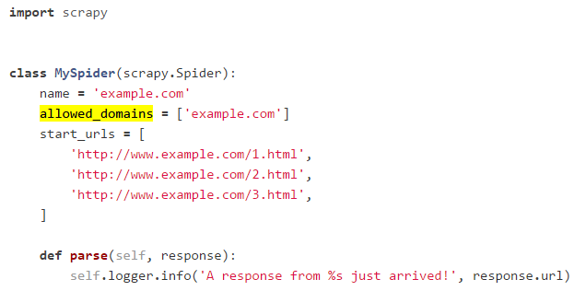
Scrapy introduction
Spiders
Spiders are classes which define how a certain site (or a group of sites) will be scraped, including how to perform the crawl (i.e. follow links) and how to extract structured data from their pages

Slide 5
Scrapy introduction
Selectors
When you’re scraping web pages, the most common task you need to perform is to extract data from the HTML source.
Ex: XPath、 css

Slide 6
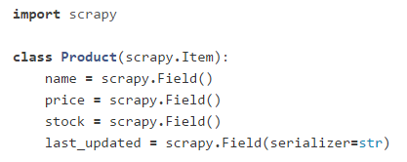
Scrapy introduction
Items
The main goal in scraping is to extract structured data from unstructured sources.

Slide 7
Scrapy introduction
Item Pipeline
After an item has been scraped by a spider, it is sent to the Item Pipeline which processes it through several components that are executed sequentially.

Slide 8
Scrapy introduction
Feed exports
One of the most frequently required features when implementing scrapers is being able to store the scraped data properly.
Ex: JSON、CSV、XML and so forth

Slide 9
urllib2 introduction
The urllib2 module defines functions and classes which help in opening URLs (mostly HTTP).

Slide 10
urllib2 introduction
Some uesful functions
urlopen()
read() #read response data
Request() #post data to url or add headers
etc..

Slide 11
comparison
Scrapy is a framework, and urllib2 is a library.
Scrapy is not easy to install(must have an Anaconda virtual enviroment), but urllib2 is installed in Python.
Scrapy has selectors to use, but urllib2 must combine lxml or BeautifulSoup to extract data.
Scrapy can export files easily, but urllib2 don’t provide functions for exporting files.

Slide 12
comparison
Scrapy’s main advantages is that it's built on top of the Twisted asynchronous networking framework which makes it very high performant.
We can see that while for urllib2 we had to write code, with Scrapy we just had to change some code that feels more like configuration than coding.

Slide 13
comparison
There's no for loop. This was expected since as we said before Scrapy needs to know just "who it needs to call".
By using Scrapy projects and infrastructure we can easily collaborate with other Scrapy developers.

Slide 14
comparison
Scrapy retries failed requests and you can customize the retrying policy, defining which kinds of response codes should be retried.
Scrapy automatically handles HTTP compression.(just set configuration)

Slide 15
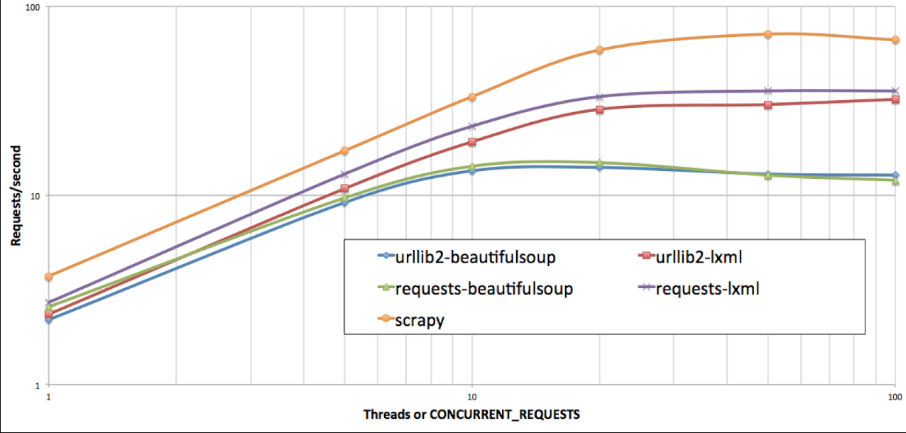
comparison

Slide 16
Thanks for watching

